Slide 1
Pressure
Game Concept by Nathaniel Lipkins-Warren

Slide 2

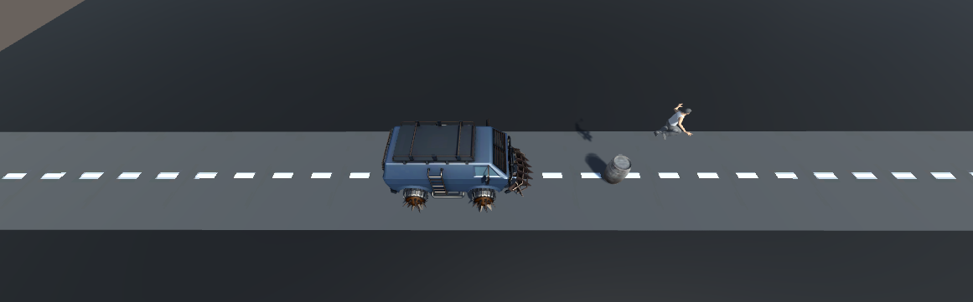
background / Story
You play as Daniel Williams, an escaped employee of Bose Inc. Daniel lives in a world where the government runs all, much more intense than a dictatorship. In this context, “runs all” includes thoughts, finances, child-birth, jobs, etc. Daniel becomes overwhelmed and escapes the facility he works in and sprints out as he is being chased by guards in a truck that was monitoring the facility.

Slide 3
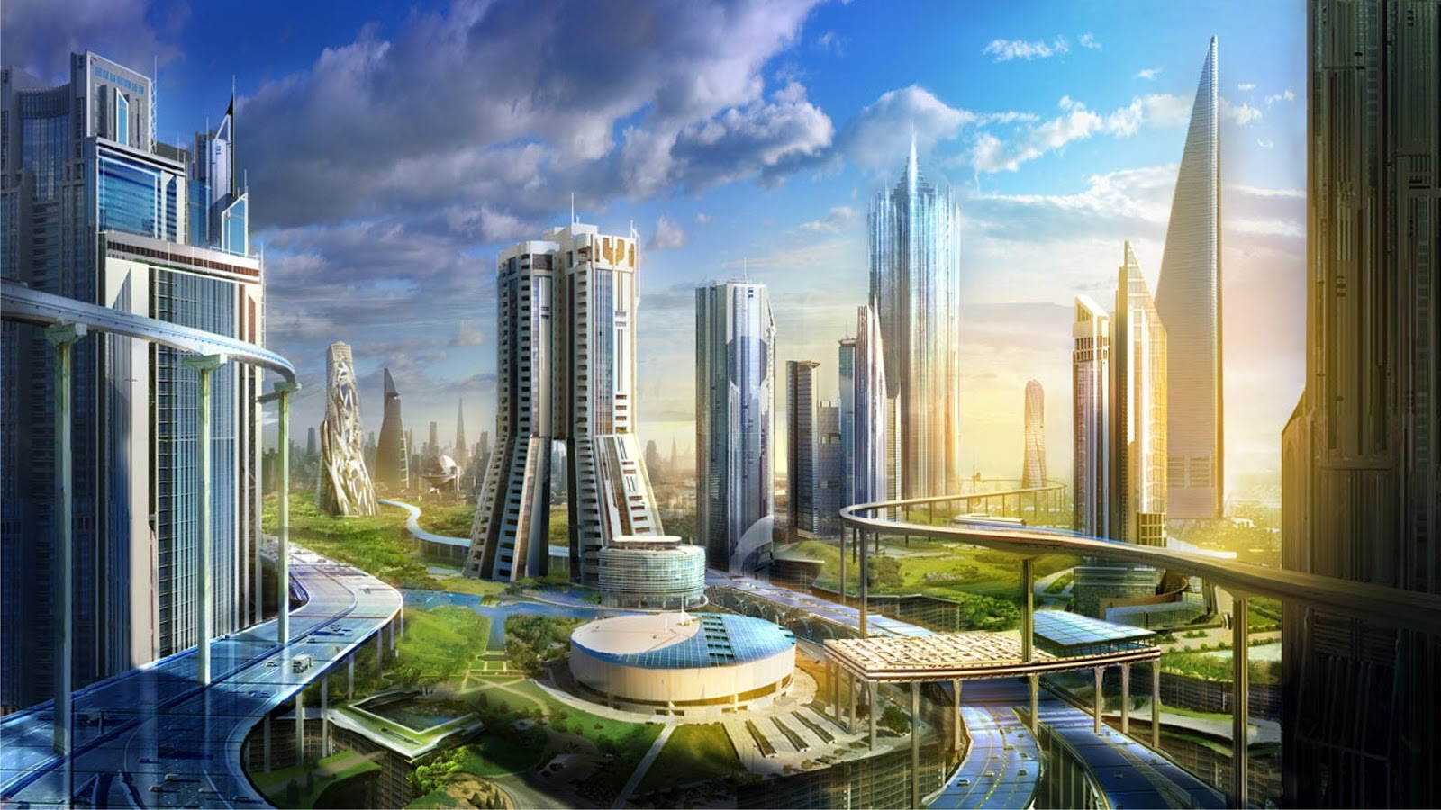
Setting
November of 2094
City called Espere (hope in Haitian Creole)
Ran by –Blank-
Capital city of Libete (freedom in Haitian Creole)
Population near the same size of New York,NY
Atmosphere feels like normal everyday life to the naked eye
Crime is very minimal
Schools excel
Not a lot of traveling in and out of the city

Slide 4
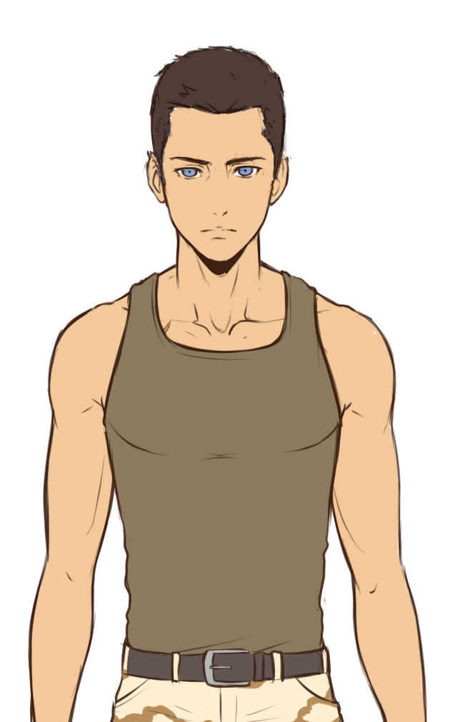
Daniel martin Williams protagonist
Born September 23rd, 2072
Currently 22
Born and raised in Mississippi
Employee of Bose Inc
Opposed to current norms of society
Family very complicated
Has family that participated in Civil Rights Movement of 1900s
Brother died in Bose protests
Mother side is anti-government
Some of his father’s side is suspected to be Bose agents

Slide 5

Bose Inc Antagonist
Strong demand for the “dull minded”
Easier to control
Has total control of the region
Similar methods used as the ones used in 1984
Implicit control similar to the Illuminati
Controls major systems and buildings like:
Government
Jobs
Schools
Supermarkets
Public does not know exactly who they are
Goes back to the implicit control
Every agent has a special bracelet designated to Bose
Has very deep history
Records go back to 9/11
Formed from conspiracies formed around America being involved with attack on 9/11

Slide 6
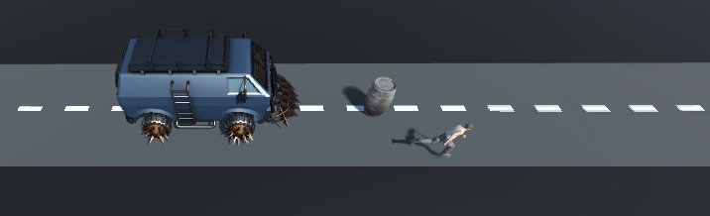
Features/How to
Main two features/functions are:
Run (Automatic)
Jump (activated by pressing the Space Bar at will)
Powerup available
Enables a double jump
Allows you to jump over bigger obstacles

Slide 7
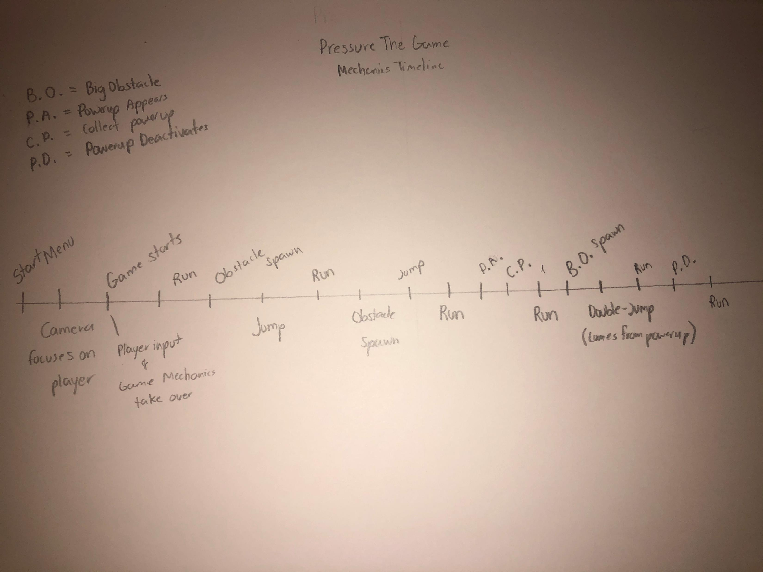
Mechanic Timeline
The image to the left display an example of how the mechanics of Pressure might function
There are different possibilities based on how you play the game

Slide 8
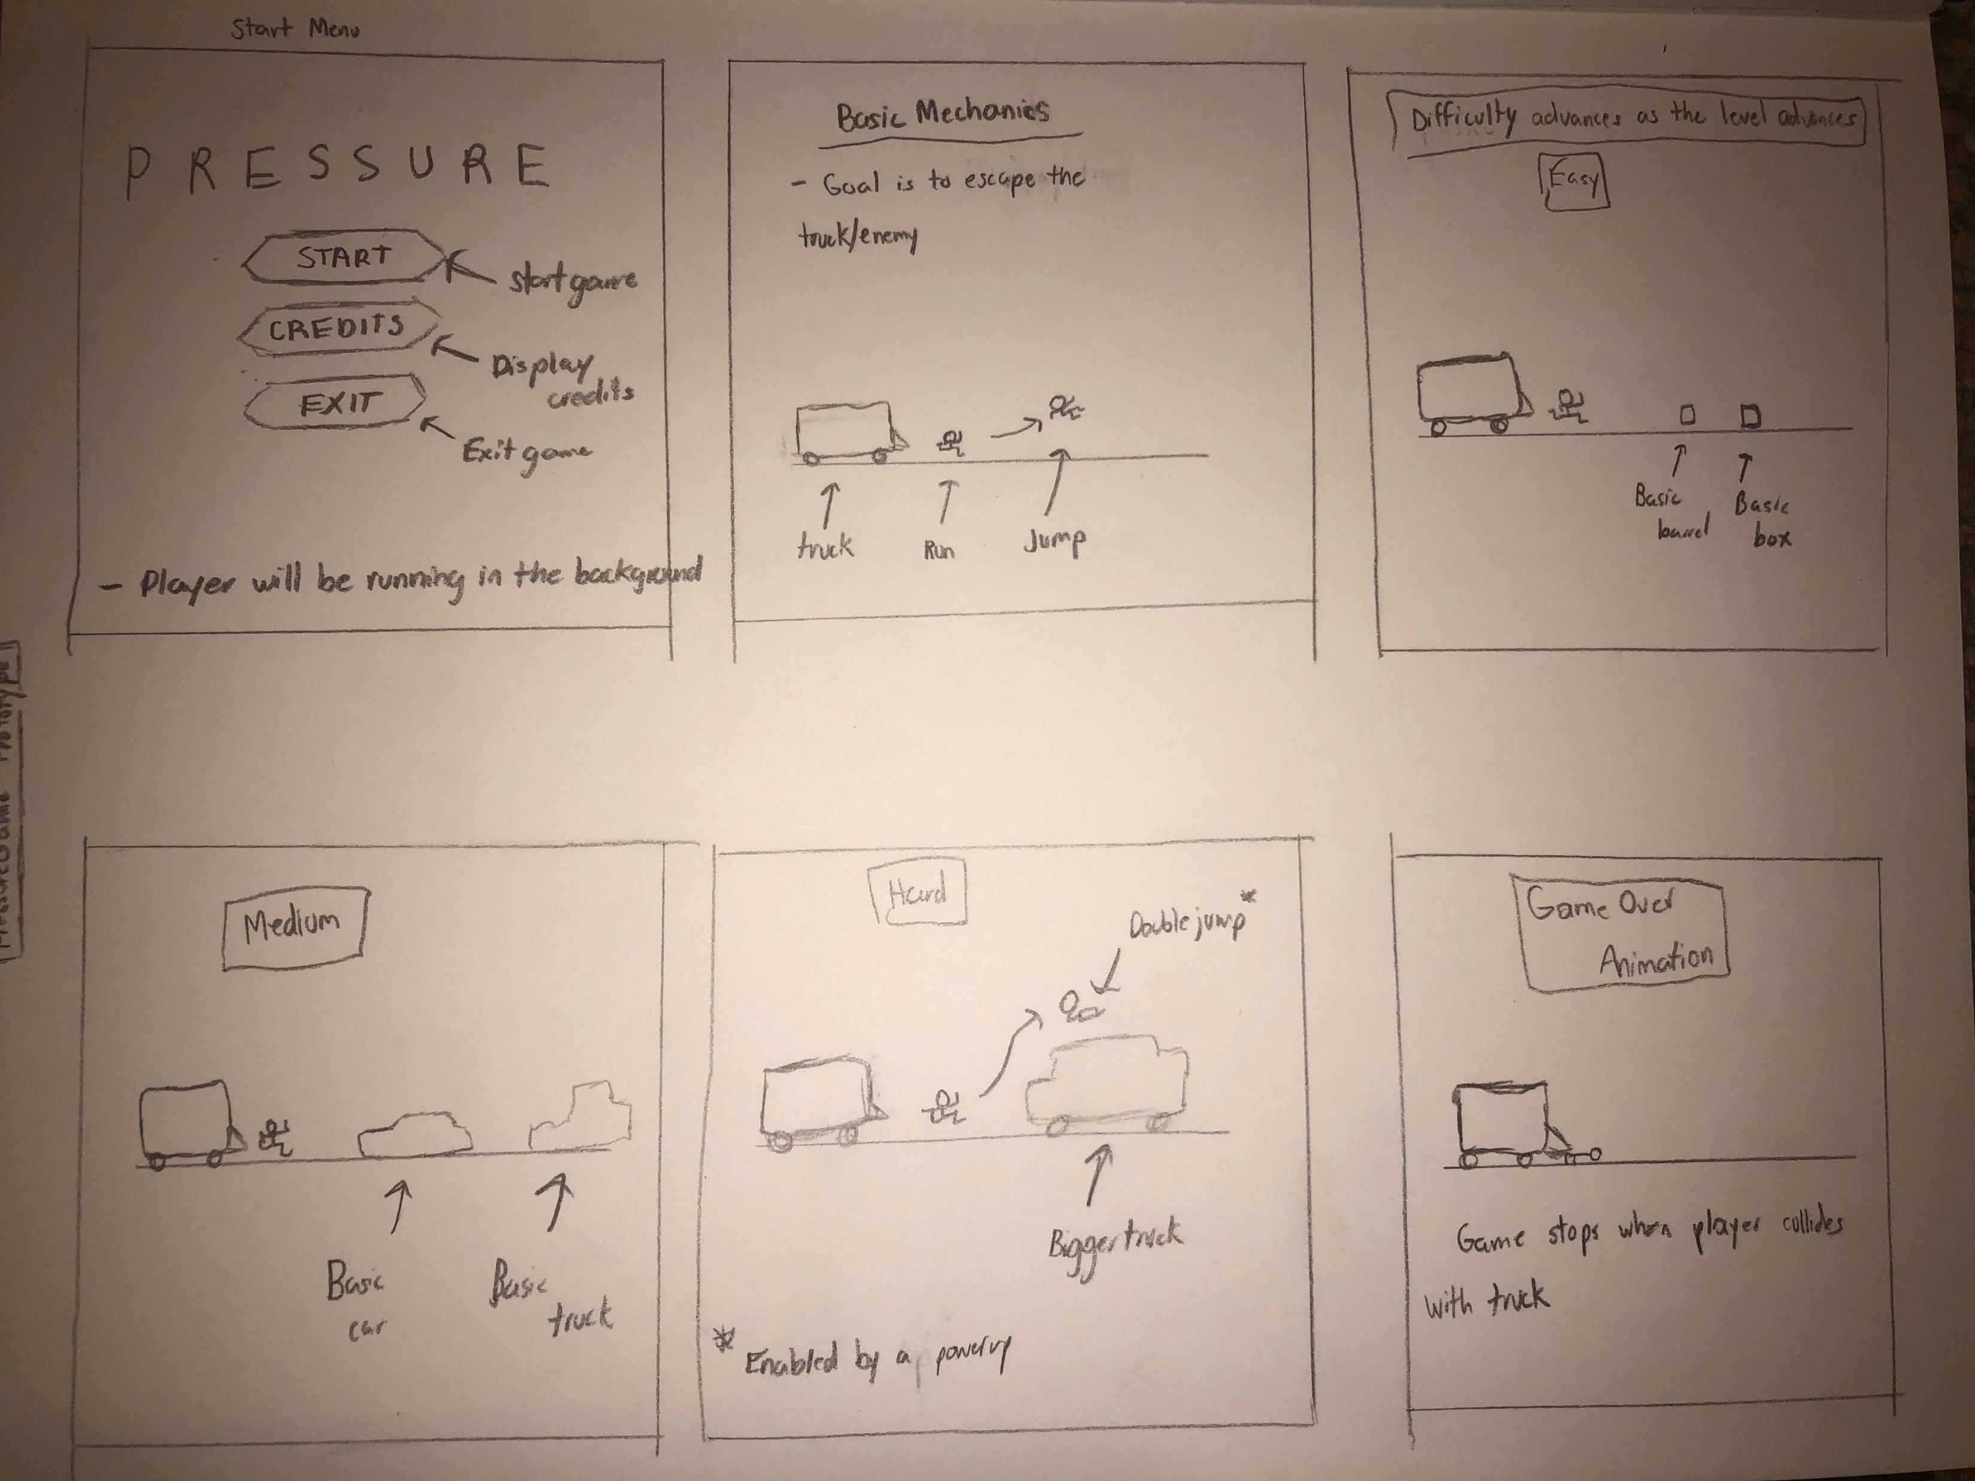
Storyboard
The image above displays the storyboard related to Pressure

Slide 9

Mood board
(images obtained from google image search)
Level design will not be as “gloomy” as the mood board
Colors will be more modern
Will feel like a normal city

Slide 10
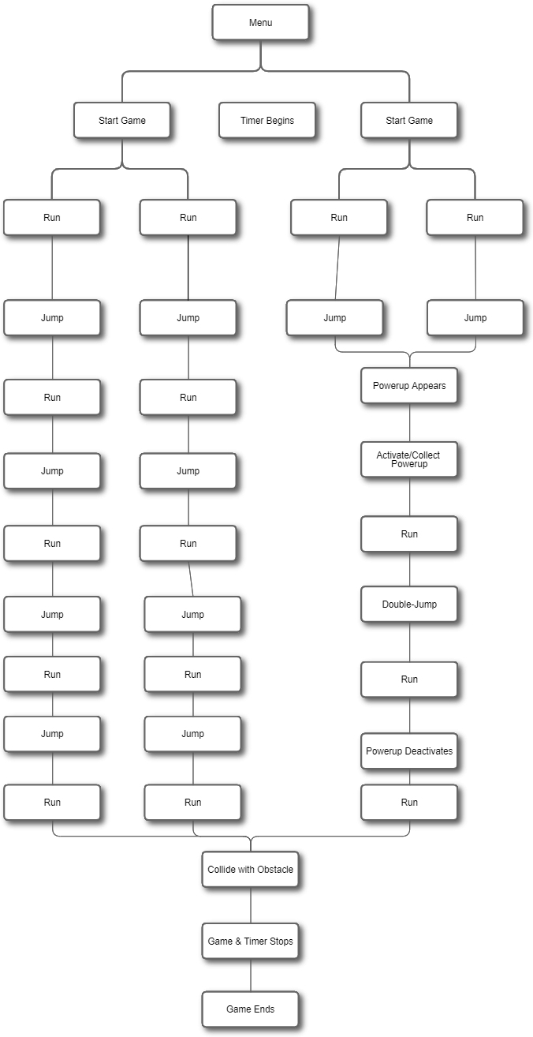
DATA FLOW
To the left is a flowchart that demonstrates the data flow/logic of Pressure

